Slide 1
Vending Machine Program Milestone 8
Purple Group-Rob Wade, Christopher Hyde, James Ray
CST-135
Professor-Charles Lively

Slide 2
Vending Machine Program-Approach
Split assignments into three parts if applicable.
James Ray-debugging and source coding
Christopher Hyde-GUI implementation
Rob Wade-UML and searching algorithms
Held meetings for the team online.
Streamline each milestone for team members.
Set completion dates for code.
Allowed collaboration of ideas in realtime.

Slide 3
Vending Machine Program-GUI Elements
Customer GUI
Manager GUI
Item Selection
Item/Cart
Login
Item Hover Identification
Checkout
Simulation GUI
Simulates Customers Purchasing
Customer Action Log
Purchase Order
Multiple Machine Management
Overall Stock

Slide 4
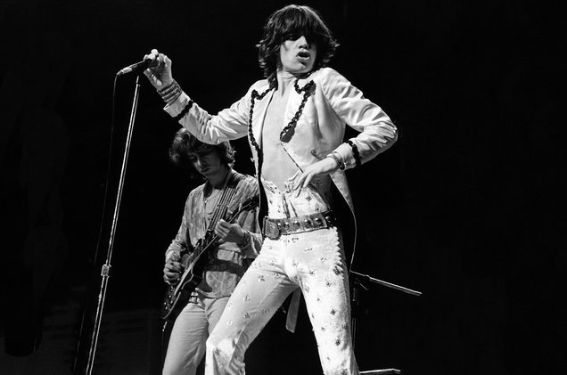
Vending Machine Program-Interesting Functions
Customer Images (Grooving Customers)
Idle animation for customers standing in line.
Animation gives life to the customer.
They have the moves like Jagger!
Example Code:
//Set key frames so that a blink happens every 20 seconds
animation.getKeyFrames().addAll(
new KeyFrame(Duration.millis(start), e -> {
idleAnimation.getChildren().setAll(idleOne);
}), new KeyFrame(Duration.millis(start + 1000), e -> {

Slide 5
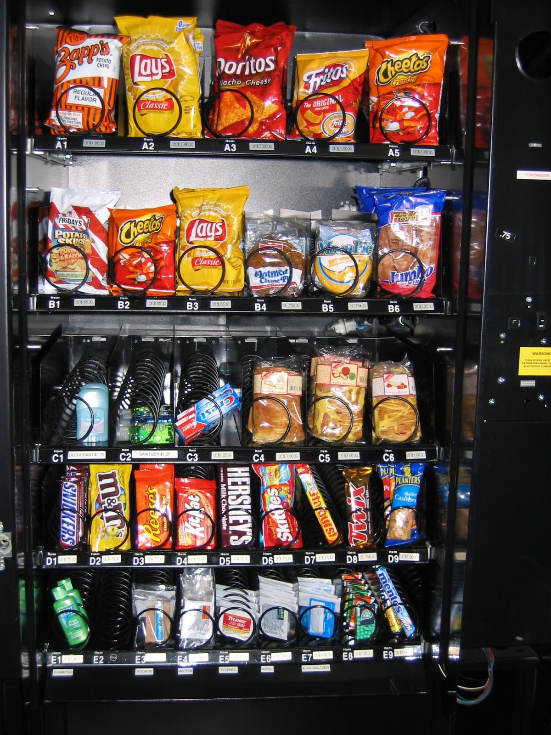
Vending Machine Program
Please be seated and enjoy the show!

